Slide 1
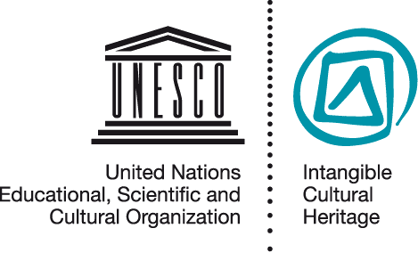
Introducing the Intangible Heritage Convention
NOM PPT 5.2
UNESCO
Intangible Cultural Heritage Section

Slide 2
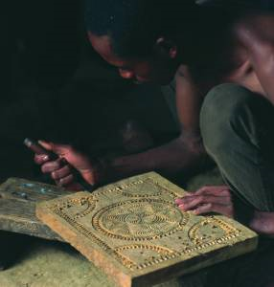
In this presentation…
UNESCO and its conventions
  The Intangible Heritage Convention
  Objectives
  Governing organs
  Two Lists and a Register
  Operational Directives
  The Fund
  Obligations and benefits
The Woodcrafting Knowledge of the Zafimaniry, © J. Ségur/ZED

Slide 3
UNESCO and its Conventions
Inter-governmental organisation with 193 member states
Education, sciences, culture and communication
7 UNESCO conventions in the area of culture and heritage
  tangible, intangible and natural heritage
  diversity of cultural expressions

Slide 4
Three related UNESCO Conventions
Convention concerning the Protection of the World Cultural and Natural Heritage (1972)
Convention for the Safeguarding of the Intangible Cultural Heritage (2003)
Convention on the Protection and Promotion of the Diversity of Cultural Expressions (2005)

Slide 5
Comparing two Conventions
World Heritage (1972)
Intangible Heritage (2003)
Conservation of immovable heritage and places
Cultural and/or natural
Outstanding universal value
Authenticity, integrity help to define value, often limiting change
Safeguarding of expressions, skills, practices, knowledge
Cultural and/or social
Communities define value as relevant to them
People enact and transmit, so ICH changes over time

Slide 6
Comparing two Conventions
Cultural diversity (2005)
Intangible Heritage (2003)
Cultural activities, goods and services (products)
Cultural expressions often new, individual creations
Focus on cultural industries, dissemination and development
Skills, practices, expressions, knowledge
ICH is a collective practice, transmitted over at least one generation
Focus on safeguarding practice and transmission of ICH

Slide 7
The Intangible Heritage Convention
  Preamble
  Objectives (art.1)
  Definitions (art.2)
  Governing organs (art.4-8)
  Safeguarding – national (art.11-15)
  Lists and Register (art.16-18)
  International assistance and cooperation (art.19-28)
  Reporting (art.29-30)
  Ratification etc. (art.32-33)

Slide 8
Objectives of the Convention
Safeguarding
Respect
Awareness
Mutual appreciation
International cooperation and assistance

Slide 9
  Two Lists and a Register
Urgent Safeguarding List
Representative List
Register of Best Practices

Slide 10
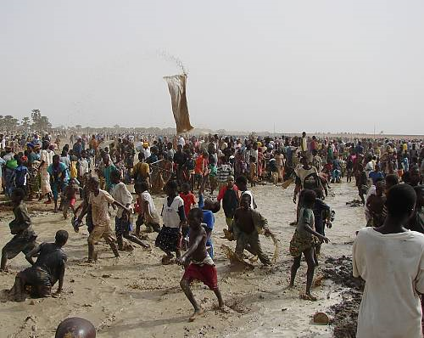
The Sanké mon: collective fishing rite of the Sanké
The Sanké mon collective fishing rite takes place annually in the Ségou region of Mali to mark the beginning of the rainy season and commemorate the founding of the town San.
In recent years, fewer people attend the rite, because of decreasing awareness of its function and history, occasional accidents and the degradation of the Sanké Lake
© Direction nationale du patrimoine culturel, Ministère de la culture du Mali

Slide 11
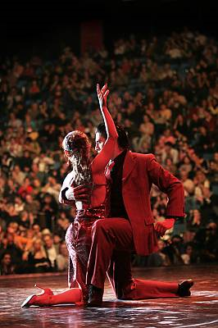
The Tango
The Tango is a symbol of the popular culture of Argentina and Uruguay, especially their capital cities. Originating in working class neighbourhoods of Buenos Aires, the Tango dates back to the late nineteenth century. Practiced spontaneously or in more formal settings, it enjoys great popularity locally and worldwide.
© 2008, by Ministerio de Cultura Ciudad de Buenos Aires

Slide 12
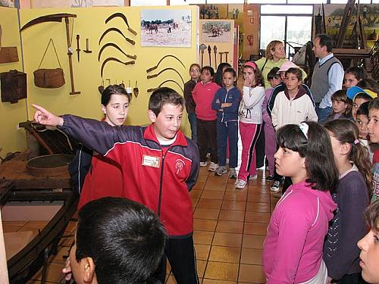
School museum of Pusol (Spain)
Guided by teachers, children explore the rich heritage of Elche by working with tradition-bearers and documenting their heritage.

Slide 13
Organs of the Convention
.
Intergovernmental Committee: 24 states members, implement the Convention.
General Assembly: sovereign body of the Convention. All States Parties are members.
UNESCO Secretariat assists in implementation of the Convention

Slide 14
Operational Directives
Guide implementation of the Convention
Include regulations and procedures for Lists and Fund
Prepared by Committee, approved by General Assembly
First set approved 2008; amended and enlarged 2010
.

Slide 15
Intangible Heritage Fund
Mainly supports safeguarding, inventory making, capacity building
States Parties contribute to the Fund
Some States make additional contributions
Few requests for assistance received so far
.

Slide 16
Exercise: Obligations of States Parties
In Articles 11-15 and 26-29 of the Convention, can you identify where it says
States Parties shall ...
States Parties shall endeavour to ...

Slide 17
Obligations of States Parties
Safeguard ICH on its territory
Ensure community participation in identifying and safeguarding
Identify, define and inventory ICH in its territory
Contribute to the ICH Fund
Report to the Committee

Slide 18
Benefits for States Parties
.
Safeguarding
International assistance
Nominating elements
International cooperation
Sharing expertise
Participating in the organs of the Convention

Slide 19
Points to remember...
.
The Convention aims to:
Safeguard the ICH
Promote cultural diversity, human creativity, mutual understanding, and international cooperation
Underscore the role of communities of tradition-bearers in the definition, enactment, transmission and safeguarding of their ICH

Slide 20
Points to remember...
.
The Convention:
Is run by an Intergovernmental Committee, controlled by a General Assembly and assisted by the UNESCO secretariat
It has Operational Directives, a Fund, two Lists and a Register of Best Practices
Brings both obligations and benefits to the States Parties

